Slide 1


New tools for performing financial analysis within the “tidy” ecosystem
R/FINANCE, 2017
Matt Dancho Founder, Director of Product Development mdancho@business-science.io | Davis Vaughan Software Engineer dvaughan@business-science.io

Slide 2
Goals
Discuss existing financial analysis landscape
Why tidyquant?
The five core tq functions
Data science at scale

Slide 3
Financial analysis landscape
xts
zoo
Quantmod
& TTR
PerformanceAnalytics
Infrastructure well-developed for Financial Analysis
Many useful functions
Data transformation
Financial analysis

Slide 4
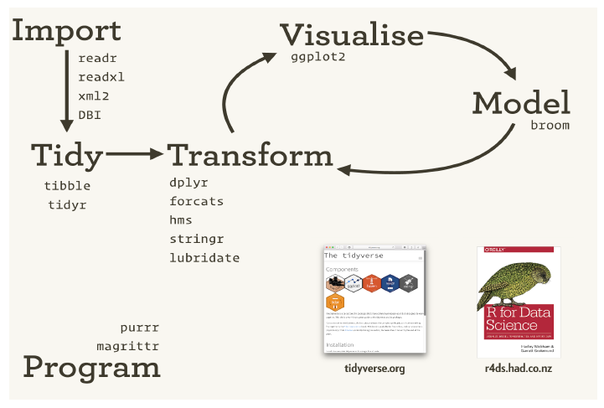
Data Science in the tidyverse
Infrastructure well-developed for Data Science
Useful workflow
H. Wickham, 2017. URL https://www.rstudio.com/resources/videos/data-science-in-thetidyverse/. [p2]

Slide 5
Two systems: Each with benefits
XTS
Built for speed
Matrix-based
Only numeric columns
Tidyverse
Built for flexibility & scale
Data frame-based
Any data type in columns
char, num, list

Slide 6
tidyquant: Best of both worlds
Integrates tidyverse with:
xts & zoo
quantmod & TTR
PerformanceAnalytics
User I/O in data frames
Internally converts to xts
Matrix speed + Data Frame flexibility
Tidyverse scalability

Slide 7
tidyquant: Five core functions
Import
tq_get
Transform
tq_transmute & tq_mutate
tq_portfolio
Model
tq_performance

Slide 8
What does scalability look like?
1 Asset | 500 Assets
tq_get(“AAPL”) | tq_index(“SP500”) %>% tq_get() %>% group_by(symbol)

Slide 9
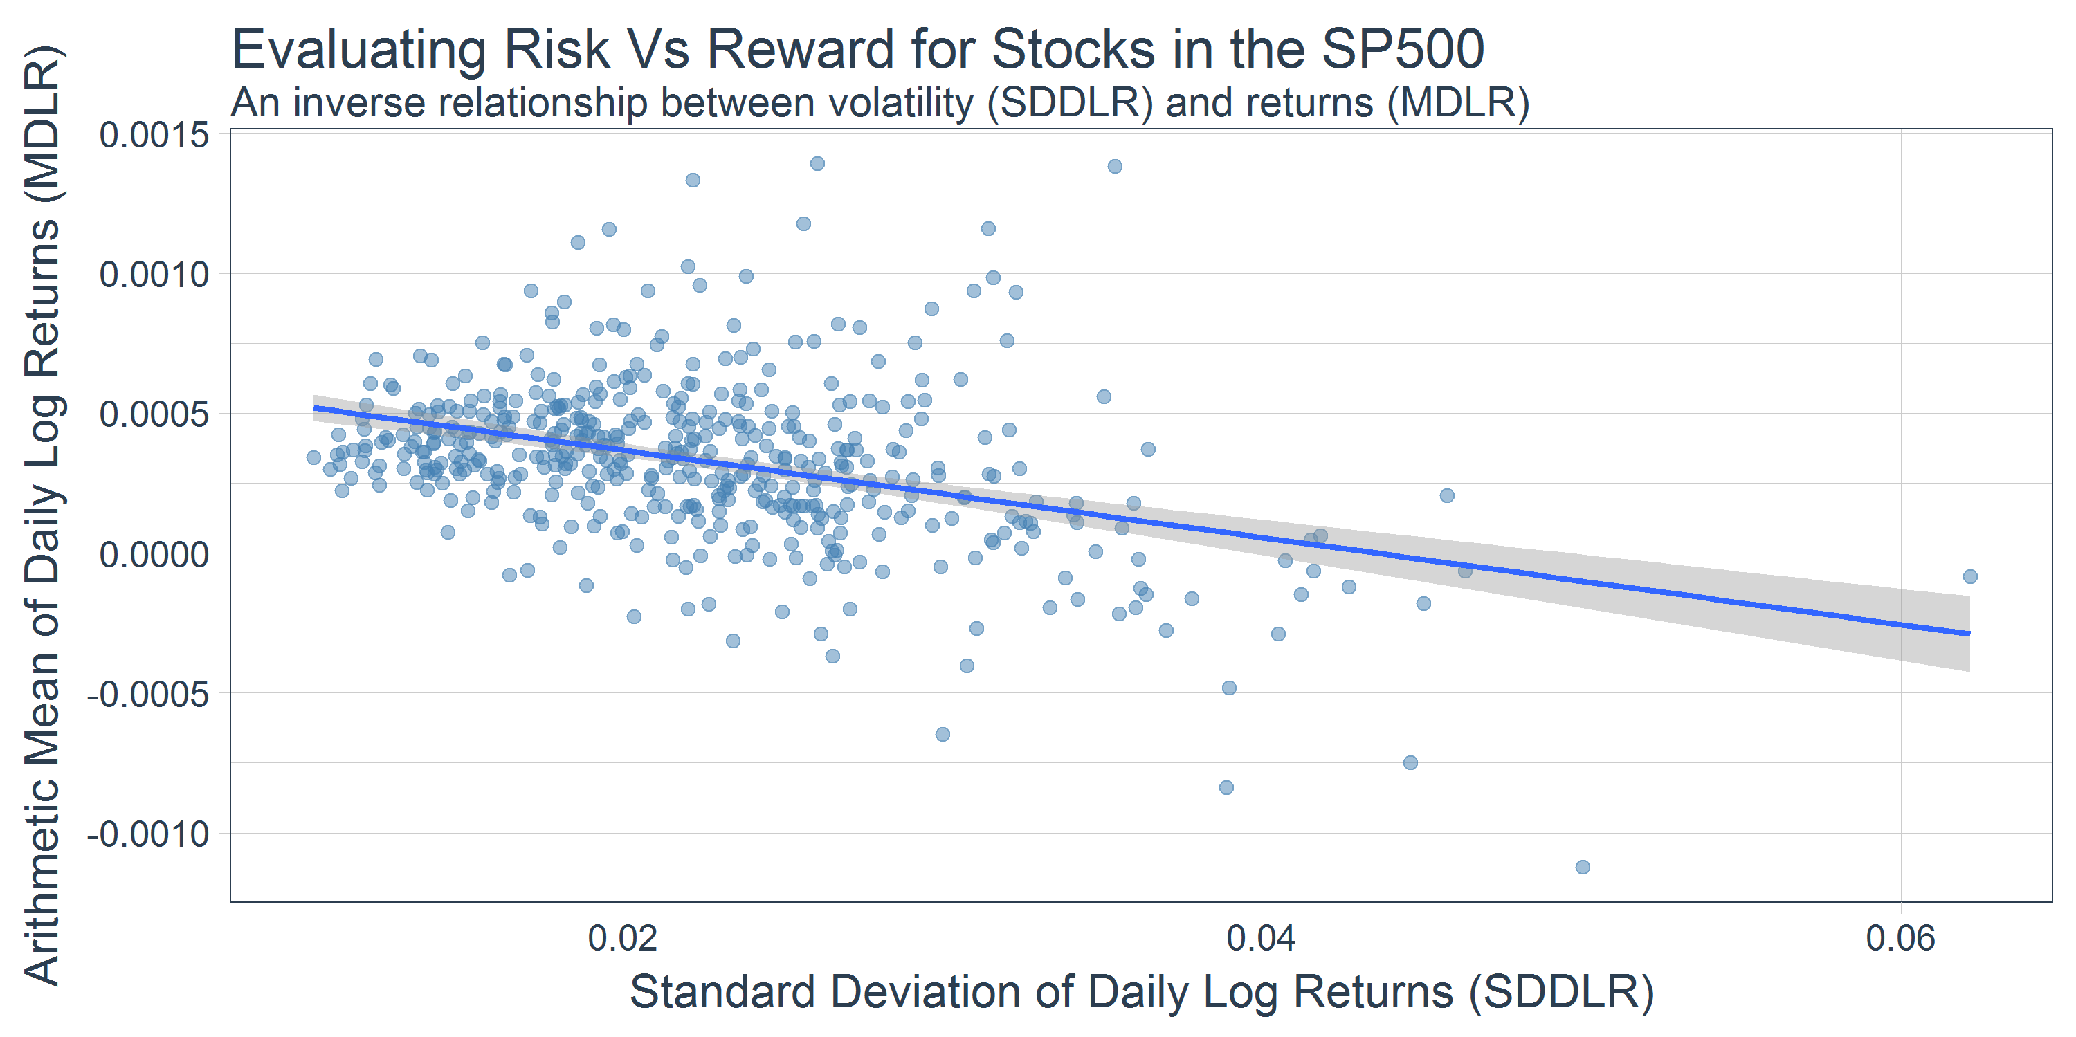
Trending MDLR & SDDLR - All S&P500 Stocks

Slide 10
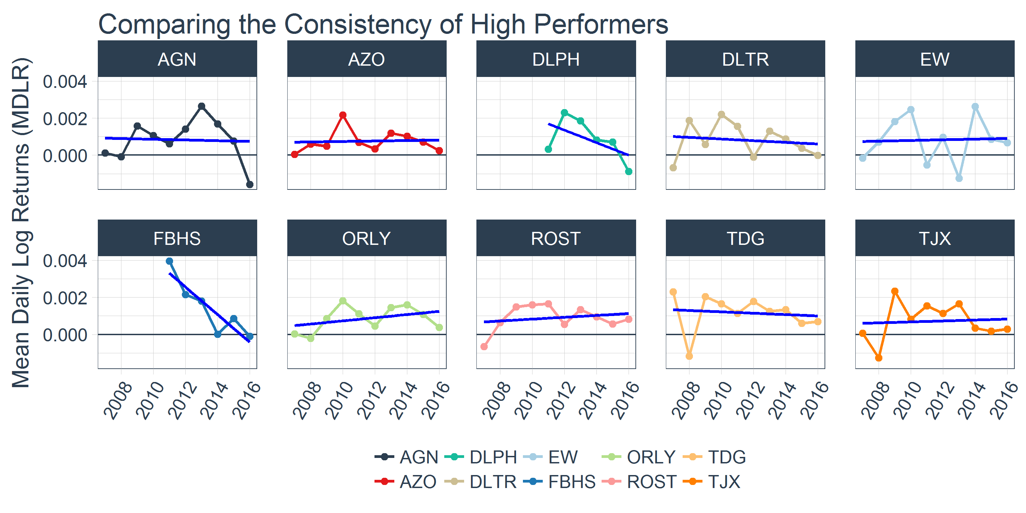
Extending analysis to MDLR by year

Slide 11
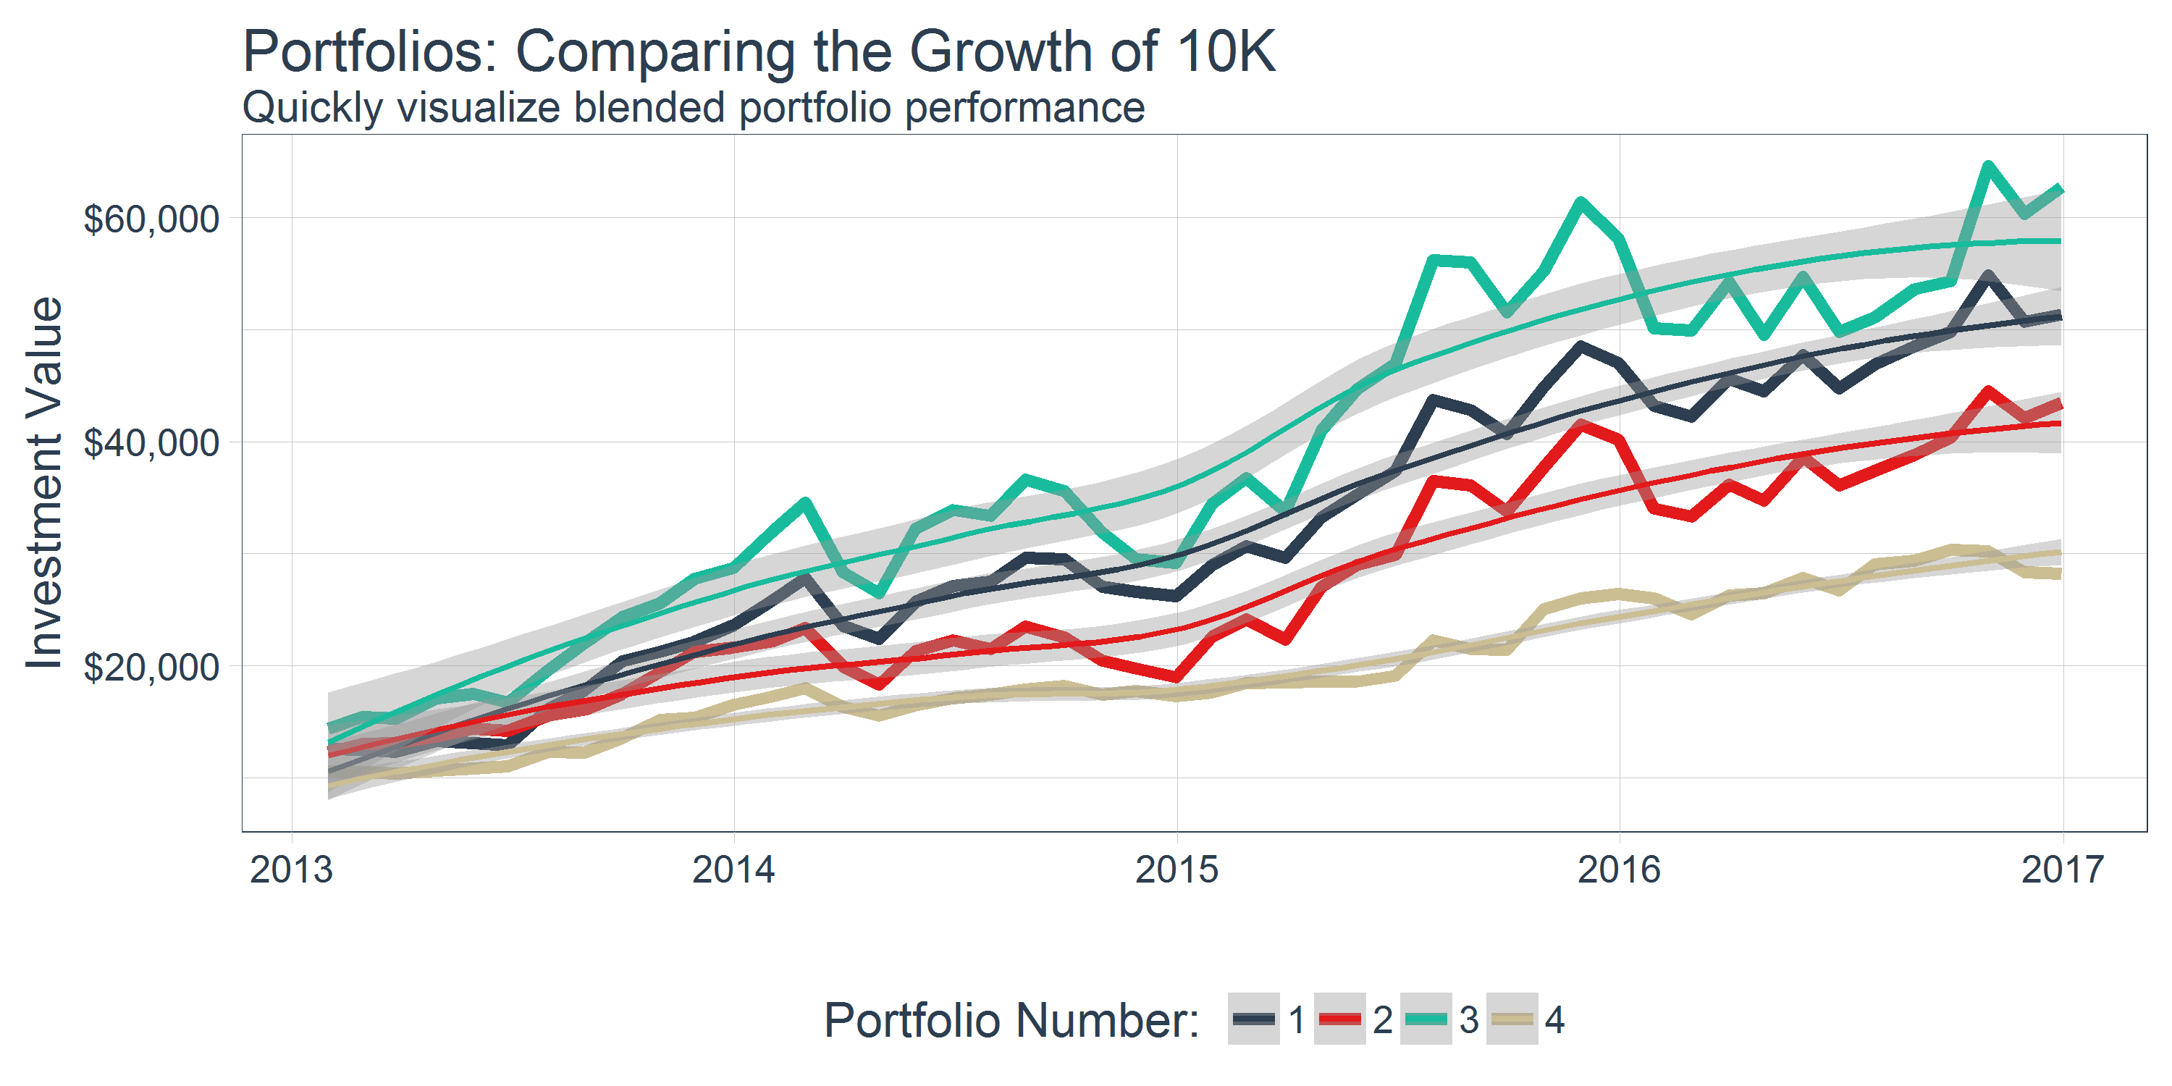
Analyzing multiple portfolio blends

Slide 12
Future…
Speed
Connectivity
Data sources
ML / AI
Flying cars

Slide 13
Acknowledgements: Standing on Shoulders
xts:
Jeffrey Ryan, Joshua Ulrich
zoo:
Achim Zeileis [aut, cre], Gabor Grothendieck [aut], Jeffrey Ryan [aut], Joshua Ulrich [ctb], Felix Andrews [ctb]
quantmod:
Jeffrey Ryan [aut, cph], Joshua Ulrich [cre, ctb], Wouter Thielen [ctb]
TTR:
Joshua Ulrich
PerformanceAnalytics
Brian Peterson [cre, aut, cph], Peter Carl [aut, cph], Kris Boudt [ctb, cph], Ross Bennett [ctb], Joshua Ulrich [ctb], Eric Zivot [ctb], Matthieu Lestel [ctb], Kyle Balkissoon [ctb], Diethelm Wuertz [ctb]
tidyverse
Hadley Wickham [aut, cre], Romain Francois [aut], RStudio [cph], & others

